Slide 1

Lecture 4
Two-Dimensional Viewing

Slide 2
Contents
4.1 Introduction
4.2 Viewing Transformation
4.3 Clipping
4.4 OpenGL Functions

Slide 3
4.1 Introduction
We now consider the formal mechanism for displaying views of a picture on an output device. Typically, a graphics package( e.g. OpenGL ) allows a user to specify which part of a defined picture is to be display and where that part is to be placed on the display device.
Any convenient cartesian coordinate system, referred to as the world-coordinate reference frame, can be used to define the picture.
For a two-dimensional picture, a view is selected by specifying a subarea of the total picture area.

Slide 4
Introduction-contn
A user can select a single area for display, or several areas could be selected for simultaneous display or for an animated sequence across a scene.
The picture parts within the selected areas are then mapped onto specified areas of the device coordinates.
When multiple view areas are selected, these areas can be placed in separate display locations, or some areas could be inserted into other, larger display areas.
Transformations from world to device coordinates involve translation, rotation, and scaling operations, as well as procedures for deleting those parts of the picture that are outside the limits of a selected display area(clipping ).

Slide 5
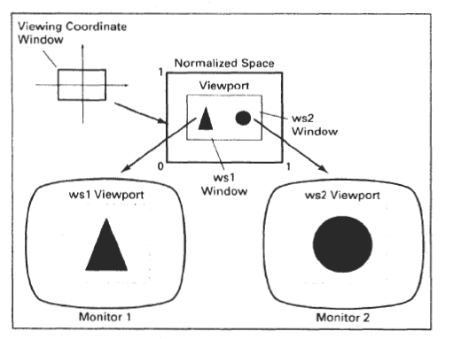
Capture before distribution on different monitors

Slide 6
4.2 Viewing Transformation
Displaying an image of a picture involves mapping the coordinates of the picture points and lines from the picture coordinate into the appropriate coordinates on the device or workstation (device coordinates) where the image is to be displayed
This is done through the use of coordinate transformation called “Viewing Transformation”
This means that the transformation map coordinates from one coordinate system to another system

Slide 7
Different Coordinate Systems
The graphic application programmer wants to define his graphical elements in a coordinate system that is related to his applications
Visual devices that are used for presenting the visual image normally have specific coordinate system (device coordinate)
so there are 3 defined coordinate systems:-
  World Coordinate System
  Normalized Device Coordinate
  Device Coordinate System

Slide 8
Coordinate Systems-cont
World Coordinate System
  It is a write-hand decomposition coordinate system, which allows the user to set any conversion dimension without being forced by any output device.
Normalized Device Coordinate ( Intermediate )
  Before final conversion to device specific coordinates ,we convert our graphics primitives to normalized device coordinates.
  It makes graphics system visible enough to match with any output graphical devices.
  Normalized Coordinate of X and Y (point coordinate) are each assigned values to the interval from 0 → 1.
Device Coordinate System
  The normalized coordinates are transformed into device coordinates within the range from (0,0) → (Xmax , Ymax) , where this is the coordinates of specific device.

Slide 9
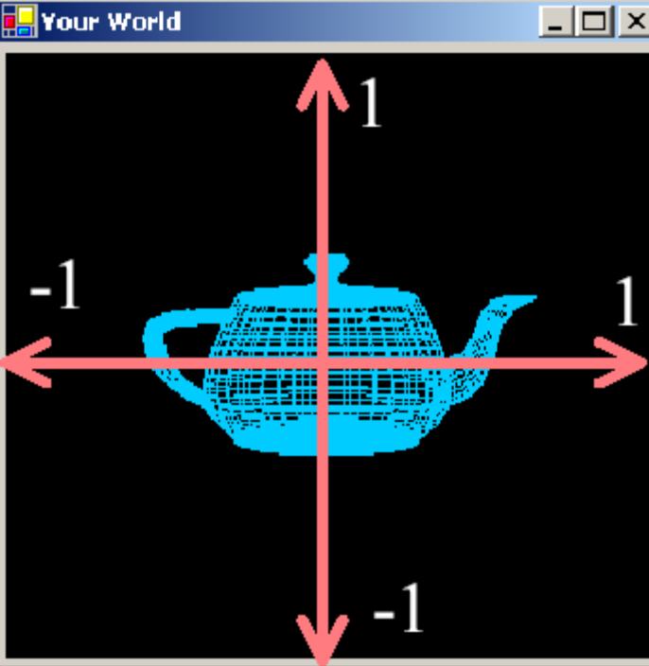
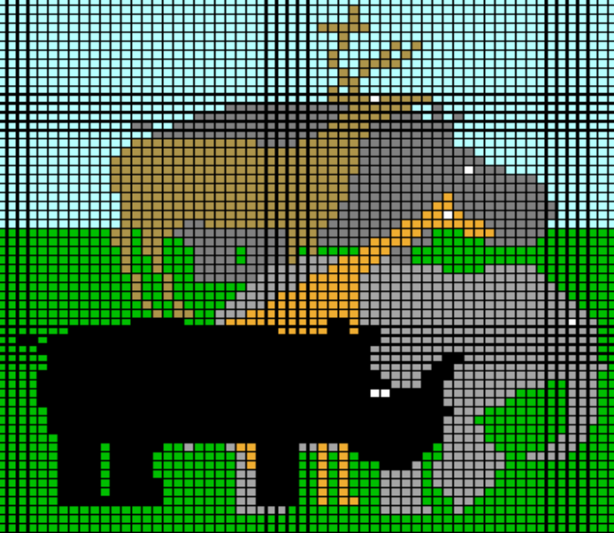
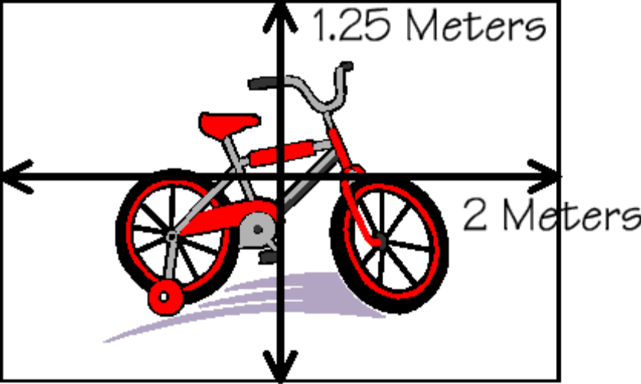
Mapping Sequence
World Space
World to NDC Mapping
Screen Space
Y
X

Slide 10
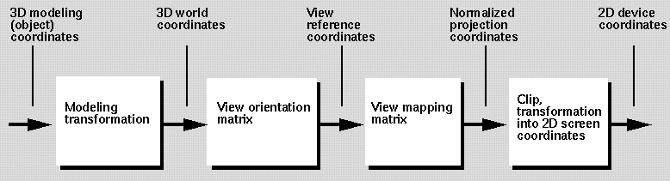
Detailed Mapping Sequence

Slide 11
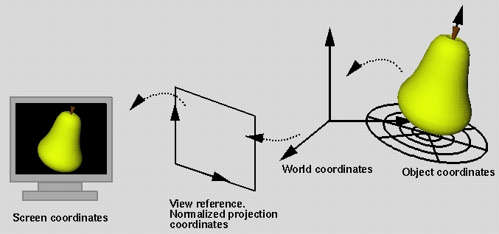
Mapping Sequence Example
1
3
2

Slide 12
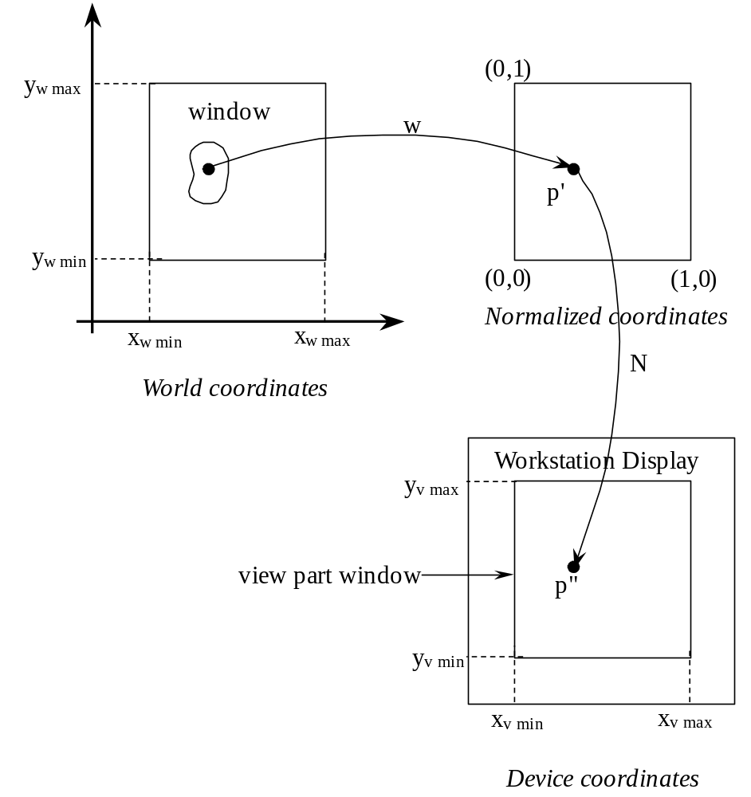
Mapping Sequence boundaries
(1,1)
2
1
3

Slide 13
World Space
Often, we want to structure our graphics independent of screen or window sizes.
We do so, by defining world space; where we specify our graphics.
World space provides the natural coordinate system for the problem at hand.

Slide 14
Normalized Device Coordinates (NDC)
Between world and screen space, we introduce an intermediate “rendering space” with normalized device coordinates.
NDC is similar to screen space,
but without any hardware display dependencies.

Slide 15
Screen Space
Ultimately, we display our images and graphics in screen space.
Pixels are addressed in screen-space coordinates.
However, screen space depends on:
resolution of the display
(the number of pixels in x and y)
size of the window that display our graphics
window aspect ratio
Y
X
aspect ratio = height/width

Slide 16
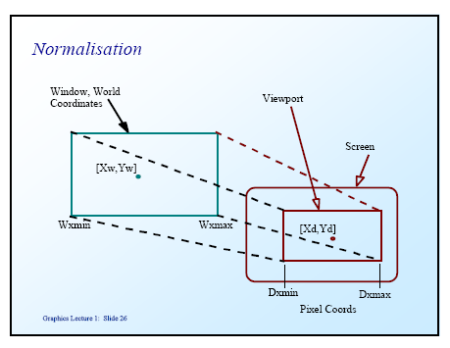
Normalization
It is a process, in which we want to see something on the screen; so we need to connect our device independent graphics primitives to the device dependent drawing commands.

Slide 17
World to View Mapping
World coordinates
( X_{W},Y_{W} )
View coordinates
( X_{V},Y_{V} )
4
4′
1′
3′
3
1
6
2
5
2′
3′
1
1′
3
For x :
=
For y :
=
4
4′
2
2′

Slide 18
World to View Mapping-contn
World coordinates
( X_{W},Y_{W} )
X_{V} = +
X_{V} = + S_{x}
Y_{V} = +
Y_{V} = + S_{y}
where scale factors are:
S_{x} = & S_{y} =
5
1′
5
1
4
1
3
6
3′
2
6
3
View coordinates
( X_{V},Y_{V} )
4′
3′
2′
4′
1′
6
2
4
5
2′

Slide 19
Assignment # 6
Given that A = ( 1,1), B = (5,1), C = (1,4), D= (5,4), I = (2,3) in world coordinates.
E = (2,2), F = (4,2), G = (2,3), H = (4,3) in view coordinates.
Compute the point J which is the projection of point I (from the world coordinates to the view coordinates).
C
D
G
H
I = (2,3)
J = ?
E
F
A
B
View Coordinates
World Coordinates

Slide 20
4.3 Clipping
Clipping refers to the removal of part of a scene
A rectangle window is specified and only part of the object, that lies inside the window, is drawn
Point clipping
line clipping
polygon clipping
(x_{max}, y_{max})
(x_{max}, y_{max})
(x_{min}, y_{min})
(x_{min}, y_{min})
Line clipping
Polygon clipping

Slide 21
4.3.1 Point clipping
Assume that the clip window is a rectangle in standard position, the point P=(x, y) will be displayed if:
If any one of the 4 inequalities is not satisfied, the point is clipped.
x_{min} < x < x_{max} and y_{min} < y < y_{max}
(x_{max}, y_{max})
P = (x, y)
(x_{min}, y_{min})

Slide 22
4.3.2 Line clipping
Clipping Lines by Solving Equations
Cohen-Sutherland Clipping Algorithm

Slide 23
1. Clipping Lines by Solving Equations
  A line is inside a clip rectangle if both endpoints lie inside. In this case, the line is said to be trivially accepted and there is no need to clip.
  For a non-trivially-accepted line F (x, y), we find the intersection with the clip rectangle by solving line equations analytically:
  Pixels shared by this line F (x, y), and an edge line Fi (x, y) are the roots of the equations:
  { Line: F (x, y) = 0, Rectangle edge: Fi (x, y) = 0 }
  There are four edges of the rectangle, thus much work needs to be done to find out the intersections ( computing the intersection of the line with the four edges )

Slide 24
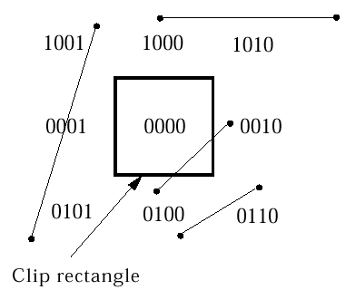
2. Cohen-Sutherland Clipping Algorithm
  Divide plane into 9 regions, each with a 4-bit code,
  using sign function = 0 if sign value >= o, otherwise = 1
  Each endpoint p (x, y) of the line segment is assigned the code of the region in which it lies:-
    First bit is set to 1 when p lies to
    left of window sign( x - xw_{min})
    Second bit is set to 1 when p
    lies to right of window sign( xw_{max} - x)
    Third bit is set to 1 when p
    lies below window sign( y - yw_{min})
    Fourth bit set is set to 1 when p
    lies above window sign( yw_{max} - y)
( case 2)
( case 2)
( case 1)
( case 2)
( case 3)
( case 2)

Slide 25
Cohen-Sutherland Clipping Algorithm-contn
The algorithm includes, excludes or partially includes the line based on where the two endpoints are:
Both endpoints are in the viewport (bitwise OR of endpoints == 0): trivial accept (case 1)
Both endpoints are on the same side of the rectangle, which is not visible (bitwise AND of endpoints != 0): trivial reject (case 2)
Both endpoints are in different parts ( case 3): In case of this non trivial situation ,the algorithm finds one of the two points; that are outside the viewport (there is at least one point outside).
The intersection of the outpoint and extended viewport border is then calculated (i.e. with the parametric equation for the line) and this new point replaces the outpoint.
The algorithm repeats until a trivial accept (case 1) or reject (case 2) occurs.

Slide 26
Cohen-Sutherland Clipping Algorithm-contn
The numbers in the figure below are called outcodes. An outcode is computed for each of the two points in the line. The first bit is set to 1 if the point is above the viewport.
The bits in the outcode represent: Top, Bottom, Right, Left. For example the outcode 1010 represents a point that is top-right of the viewport.
Note that the outcodes for endpoints must be recalculated on each iteration after the clipping occurs.

Slide 27
Cohen-Sutherland Clipping Algorithm
repeat
Check for trivial accept( case 1) or trivial reject ( case 2)
Pick the point outside the clip rectangle.
if TOP
x = x0 + (x1 – x0) * (ymax – y0)/(y1 – y0);
y = ymax;
else if BOTTOM
x = x0 + (x1 – x0) * (ymin – y0)/(y1 – y0);
y = ymin;
else if RIGHT
y = y0 + (y1 – y0) * (xmax – x0)/(x1 – x0);
x = xmax;
else if LEFT
y = y0 + (y1 – y0) * (xmin – x0)/(x1 – x0);
x = xmin;
end all ifs
until done
// Cohen–Sutherland clipping algorithm clips a line from // P0 = (x0, y0) to P1 = (x1, y1) against a rectangle with // diagonal from (xmin, ymin) to (xmax, ymax).
Input: x0, y0, x1, y1: the line segment to be clipped
Output: x0, y0, x1, y1: the resulted segment

Slide 28
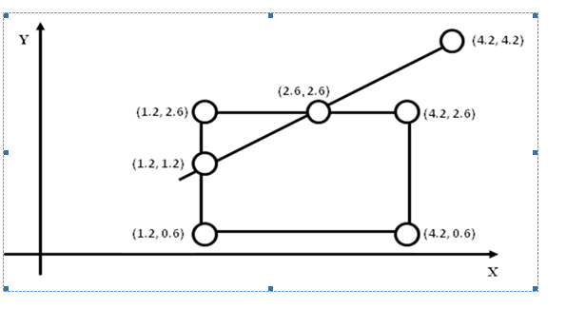
Assignment # 7
(0.8,0.8)
(a) Compute, analytically; the visible and invisible part of the line connecting ( 0.8,0.8) to ( 4.2,4.2)
(b) Use Cohen-Sutherland Clipping algorithm to compute the visible and invisible part of the same line.
Note: Visit our user group to simulate your solution using the link: http://www.image.ece.ntua.gr/old/epeaek/clip.html

Slide 29
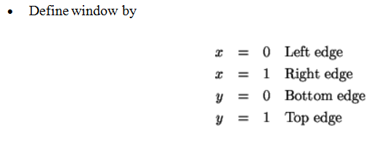
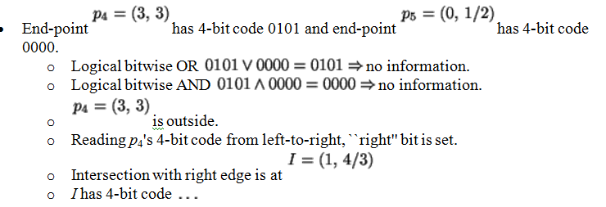
http://www.image.ece.ntua.gr/old/epeaek/clip.html

Slide 30
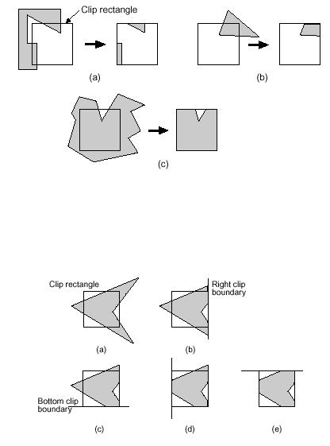
4.3.3 Polygons Clipping
Polygon clipping differs from line clipping in several respects:
  The input to the clipper is a polygon, which for simplicity we will view as a list of vertices
  The output from the clipper is one or more polygons
  The clipping process may generate vertices that do not lie on any of the edges of the original polygon

Slide 31
Sutherland-Hodgeman Polygon Clipping
Its basic idea is to implement processing for the polygon boundary against each window edge, using polygon vertices.)
Given a subject polygon with an ordered sequence of vertices
Sutherland-Hodgeman compares each subject polygon edge against a single clip window edge, saving the vertices on the in-side of the edge and the intersection points when edges are crossed.
The clipper is then re-entered with this intermediate polygon and another clip window edge.

Slide 32
Given a clip window edge and a subject polygon edge, there are four cases to consider:
  The subject polygon edge goes from inside clip window edge to inside clip window edge. In this case we save second inside point (the first was saved previously).
  The subject polygon edge goes from inside clip window edge to outside clip window edge. In this case we save intersection point.
  The subject polygon edge goes from outside clip window edge to outside clip window edge. In this case we output nothing.
  The subject polygon edge goes from outside clip window edge to inside clip window edge. In this case we save intersection and inside vertex.
inside
outside
inside
outside
inside
outside
inside
outside
v_{k}
v_{k-1}
v_{k}
p
v_{k-1}
p
v_{k-1}
v_{k}
v_{k-1}
v_{k}
Output v_{k-1}
Output p
No output
Output v_{k-1}, p

Slide 33
Sutherland-Hodgeman Polygon Clipping Algorithm
arrayLength = array.size
vertex S = array[ arrayLength - 1 ]
for( j = 0, j < arrayLength, j = j+1 )
{
vertex P = array[ j ]
if( P is inside clip_plane )
{
if( S is not inside clip_plane )
{
Output( ComputeIntersection( S, P, clip_plane ) )
}
Output( P )
}
else if( S is inside clip_plane )
{
Output( ComputeIntersection( P, S, clip_plane ) )
}
S = P
}

Slide 34
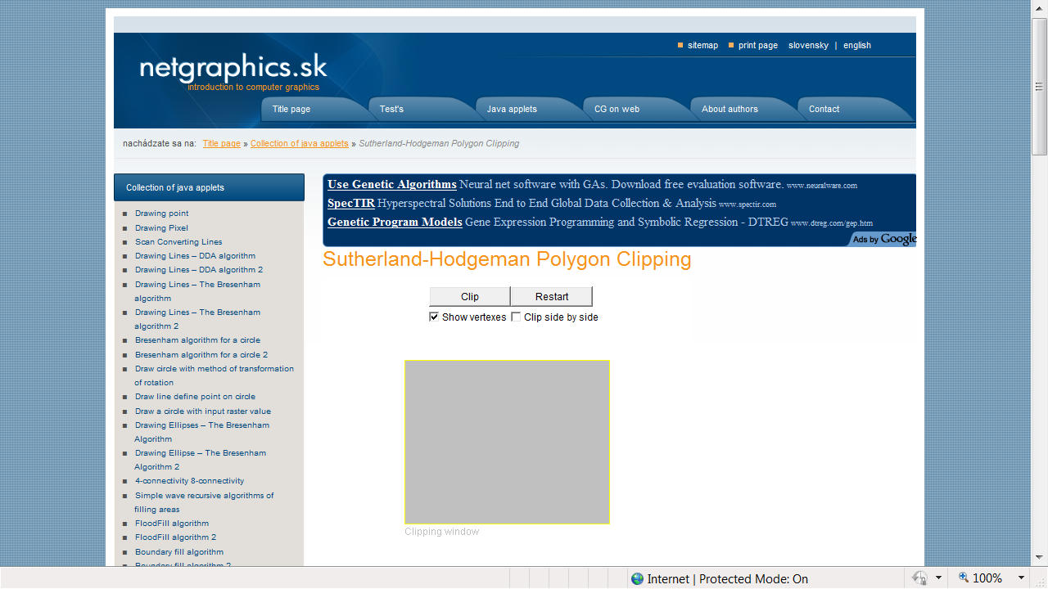
Ref: http://www.netgraphics.sk/sutherland-hodgeman-polygon-clipping

Slide 35
4.4 OpenGL Functions
GLUT code to establish a window on the screen:
glutInitWindowSize(400, 400);
glutInitWindowPosition(100, 100);
NDC-to-screen mapping:
glViewport(0,0,(GLsizei)w,(GLsizei)h);
World-to-NDC mapping:
gluOrtho2D(w.left,w.right,w.bottom,w.top);

Slide 36
Summary OpenGL Vertex Transforms
Object coords
(x y z w)^{t} vertex
Clip coordinates
Perspective Divide
(Dehomogenization)
Normalized Device
Coordinates
Modelview matrix
[Object Transforms
and gluLookAt]
Viewport Transform
(glViewport)
Eye coordinates
(used for lighting)
Projection matrix
[3D to 2D, usually
gluPerspective]
Window Coords

